Slide 1

MVP 2 : Validation, Learnings
Chirag Huria, Alana Mittleman, Rohan Paliwal, Elias El Kozah
for Digital Service Innovation

Slide 2
MVP Description - Shopper Experience
The problem we identified in early research is that people who are buying art spontaneously may end up being dissatisfied with their purchase or feeling wasteful because they realize they do not have a spot in their living space to hang the art. In our first iteration, we examined how we could prevent that by giving shoppers a way to visualize the art they are buying in their homes while they are shopping in person or online.
In validating our first iteration, we realized the problem did not end there. We saw that shoppers who use our service and decide they cannot place the art they are viewing in their home way experience disappointment over leaving the piece behind. At this point, MUSE can extend the experience. We can ask users why the piece did not work out, and then recommend alternatives that are more appropriate in size, color, style, or other dimensions.

Slide 3
MVP Description - Value Flow
With MUSE as a service that can collect information about how people shop for art and rule pieces out on certain criteria, and facilitates recommendations that lead to sales, we can collect information that may be of value to several parties.
Artists who want their work to be recommended to users on MUSE can receive information when a recommendation converts to a sale, and what criteria made the user accept the recommendation.
Data about how users shop for art is also of value to arts and arts management degree programs, as well as art galleries.

Slide 4
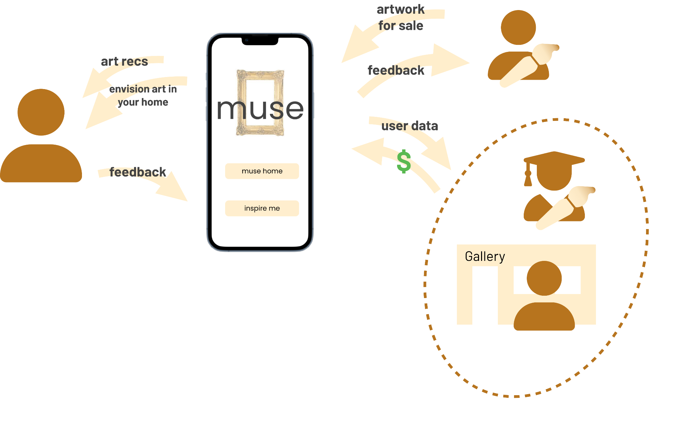
MVP Description - Value Flow

Slide 5
Validation
Method
Learning Goals
To validate MVP 2, we conducted ~8 interviews with potential users (low cost art shoppers) as well as artists who have sold art either through an online storefront, at exhibitions, or through commissions.
With artists, we conducted semi structured interviews to learn what type of feedback they benefit from in selling their art.
Users | Artists
Can app recommendations convince users to buy a piece of art After deciding against a piece of art for logistic reasons, do recommendations reduce feelings of disappointment | What type of feedback do artists currently seek from customers What other entities may benefit from data muse can collect What motivates artists to increase their customer base

Slide 6
Insight
1
Artists who do not rely on sales as a source of income view feedback differently
These artists are not as motivated to increase their sales, as art is not their livelihood. Therefore, feedback to increase their customer base is not valuable to them. They complete commissions primarily for enjoyment, so making sure they are matched to a customer who shares goals and interests is important to them.

Slide 7
Insight
2
Many artists do not value increasing sales over maintaining their personal style
Whether an artist considers their craft a source of income or not, their are core qualities of their art that they would not be willing to change to increase sales. For artists we talked to, it seems that the important quality can best be described as personal style.

Slide 8
Insight
3
Recommending art to replace a piece that a user had to leave behind interrupts feelings of disappointment
In our mvp 1 validation, we found that when a user discovers that a piece of art won’t look good in their space it is disappointing. In this iteration, we offered users the possibility of getting similar art recommended to them when this happens. This seemed to address the feeling of let down.

Slide 9
Insight
4
Some artists who are experienced in sales feel that they have enough consumer insights.
With many years of sales experience, some artists believe that they have a clear understanding of their target market like age demographics, genders and what makes their customers engaged. For example, a tattoo artist says that flowers and pets are the most popular drawings among her female customers.

Slide 10
Insight
5
Some artists value talking to the customer over data analytics.
Some artists have a more intimate view of getting customer insights and they consider it an essential part of the art creation process. They don’t value the usage of data analytics and the aggregation of big data to come up with insights. They prefer to go on a personal journey of customer discovery through dialogue and negotiation with their customer of what goes into the final piece of art.

Slide 11
Insight
6
Insight
Detail

